Slide 1

Immune Receptor Profiling Nanocourse
Introduction Session
Organized by the VDJServer Team
June 1, 2018
UT Southwestern Medical Center

Slide 2
AGENDA
8:45am – 9:00am Setup, Registration, provide workshop handouts to participants
9:10am – 10:30am Introduction session
9:10am – 10:30am: Immune system overview (including immune sequencing technology and summary of vdjserver workflow for analysis); Setup IgBlast jobs with demo files
Using slides and video
10:30am-10:40am Break
10:40am – 11:45am Session 1: Data digest
Demo data and VDJServer hands-on demonstrations
Elaborate on the functionalities and benefits of VDJServer such as: no need to install anything, reproducibility, easy to use, data is stored on your account and is private, collaborative sharing of data, and long term archiving.
Breakout and setup RepCalc VDJServer “jobs” (provide one-on-one assistance and point participants to quickstart protocol @ handout pages)
11:45am – 1:00pm Lunch
1:00pm – 2:40pm Session 2: Community standards, Data analysis and interpretation
Example of pre-processing using example FASTQ files (from community data)
AIRR Standards- (MiAIRR)
Analysis and interpretation of repertoire calculations output
2:40pm-2:55pm Break
3:00pm-3:45pm
Downstream application of VDJServer products in machine learning (example dataset using the demo dataset and discussion of some outcomes)
3:45pm-4:30pm
Summarize the workshop and encourage future interactions
Invitation to use some example datasets for further analysis (VDJServer team will assist in setup as time permits)

Slide 3
Introduction session points
Immune system overview
Approaches to immune sequencing
Applications of immune sequencing
**Set up demo data** (IgBlast application)
Workflow and key steps
AIRR community and data standards

Slide 4
Immune system overview
The immune system is the body's defense against infectious organisms and other invaders.
Through a series of steps called the immune response, the immune system attacks organisms and substances that invade body systems and cause disease.
The immune system is made up of a network of cells, tissues, and organs that work together to protect the body.
https://www.ncbi.nlm.nih.gov/books/NBK21070/

Slide 5
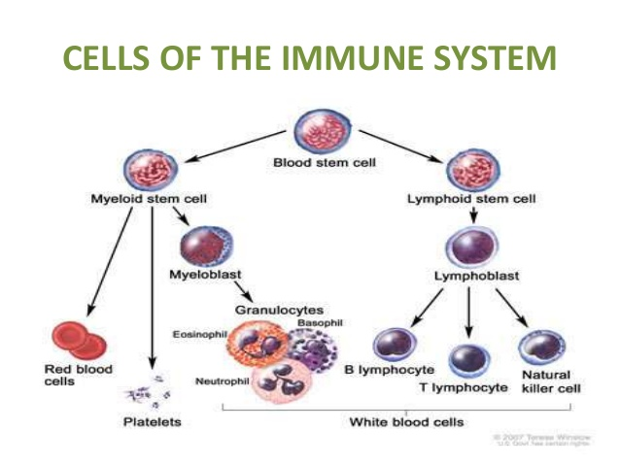
https://www.cancer.gov; Terese Winslow 2007

Slide 6
White blood cells (Leukocytes)
One of the important cells involved are white blood cells, also called leukocytes, which come in two basic types (phagocytes and lymphocytes).
Leukocytes are produced or stored in many locations in the body, including the thymus, spleen, and bone marrow. For this reason, they're called the lymphoid organs.
Lymph nodes also house the leukocytes.
https://www.ncbi.nlm.nih.gov/books/NBK21070/

Slide 7
Lymphocytes (type of leukocyte)
The two basic types of leukocytes are:
phagocytes, cells that chew up invading organisms
lymphocytes, cells that allow the body to remember and recognize previous invaders and help the body destroy them
The most common type of phagocyte is the neutrophil, which primarily fights bacteria.
The two kinds of lymphocytes are B lymphocytes and T lymphocytes.
B lymphocytes and T lymphocytes have separate functions: B lymphocytes seek out their targets and send defenses to lock onto them. T cells destroy the invaders that the system has identified.
https://www.ncbi.nlm.nih.gov/books/NBK21070/

Slide 8
Immune system
The immune system is dynamic in nature; humans have 3 types of immunity:
Innate, Adaptive and Passive immunity
Innate Immunity
Everyone is born with innate (or natural) immunity, a type of general protection. Innate immunity also includes the external barriers of the body, like the skin and mucous membranes (like those that line the nose, throat, and gastrointestinal tract),
Adaptive Immunity
The second kind of protection is adaptive (or active) immunity, which develops throughout our lives. Adaptive immunity involves the lymphocytes and develops as people are exposed to diseases or immunized against diseases through vaccination.
Passive Immunity
Passive immunity is "borrowed" from another source and it lasts for a short time. For example, antibodies in a mother's breast milk give a baby temporary immunity to diseases the mother has been exposed to.
https://www.ncbi.nlm.nih.gov/books/NBK21070/
"Vaccines: Vac-Gen/Immunity Types". www.cdc.gov

Slide 9
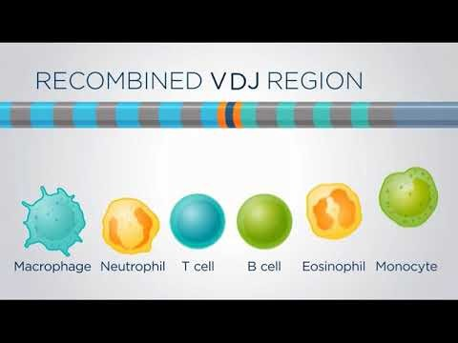
Introduction to Adaptive Immune System

Slide 10
Video 1
https://vimeo.com/269299293
Enter password

Slide 11
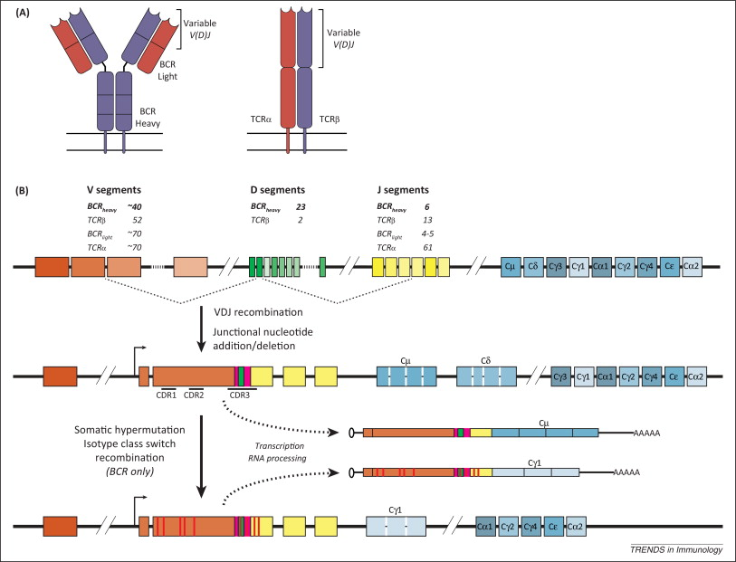
Schematic for VDJ recombination in B and T cells
PMID: 25306219

Slide 12
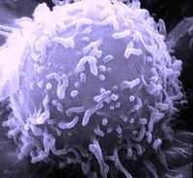
Summary
Adaptive immunity provides us with the ability to fight off infections and pathogens as well as provides long term immune protection and maintainance of immune system homeostasis
B-cells and T-cell have become the focus of intense research using novel sequencing technology known as immune receptor sequencing.
Diverse lymphocyte repertoires can be analyzed by high throughput sequencing.

Slide 13
Approaches to Immune Sequencing (brief background)
Several different High throughput sequencing (HTS) platforms are available for sequencing antigen receptor repertoires.
Each method differs in read lengths, sequencing depth, error frequency, and error type, all of which impact B-cell receptor (BCR) and T-cell receptor (TCR) analysis.
Approaches to account for ‘real’ errors introduced during library preparation vary among different HTS platforms.
For example, Roche-454, Ion Torrent, and Pacific Biosciences instruments are prone to insertions or deletions (indels), which are relatively rare on Illumina technology.
PMCID: PMC4390416

Slide 14
Approaches to immune sequencing (selected methods)
1) Sanger sequencing
2) 5’ SMART Race PCR (vector and adapter)
3) Multiplex PCR (bias-controlled approach from Adaptive Biotechnologies)

Slide 15
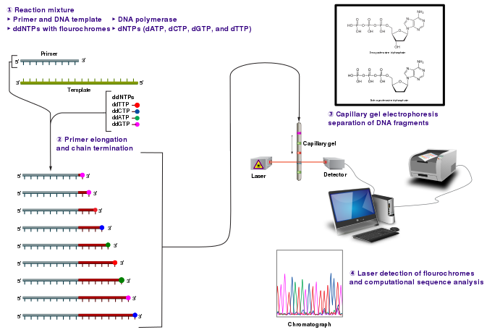
Sanger sequencing
Sanger sequencing allows the identification of cDNA segments encoding variable regions of immunoglobulin (B-cell receptors) (or T-cell receptors).
Due to its limitations on quantity only a small fraction of the immune repertoire (B and/or T cell receptors) can be interrogated with this method.
PMID: 7602095

Slide 16
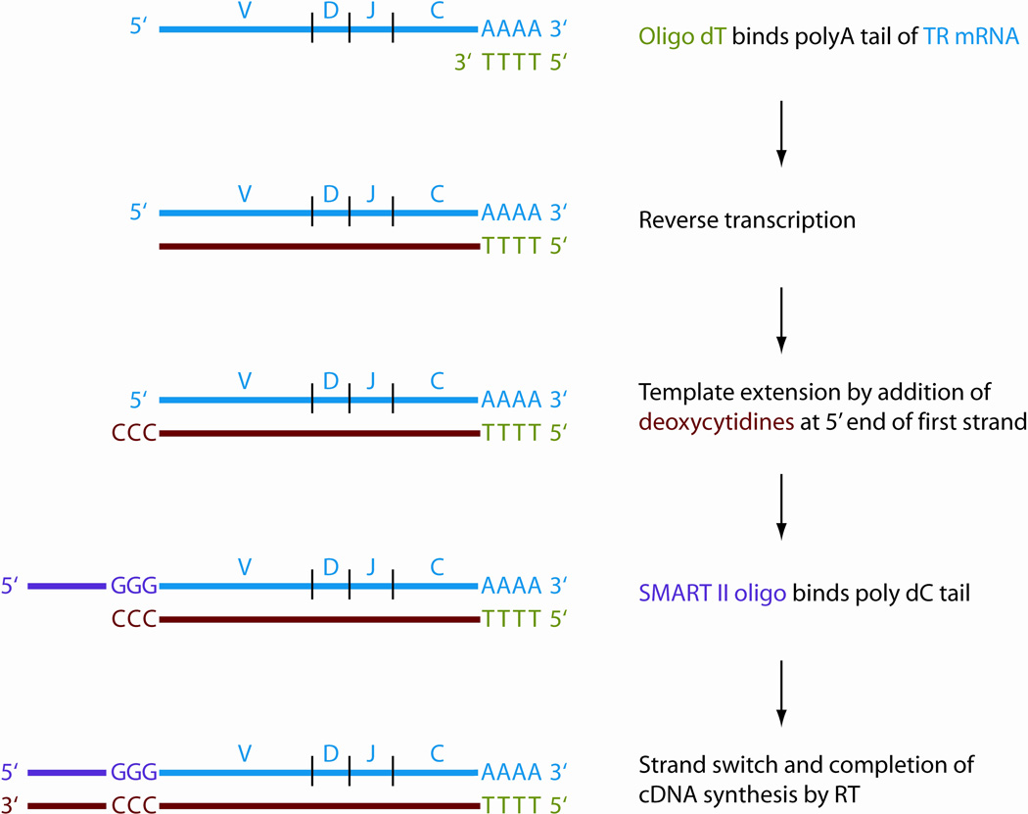
5’ SMART RACE (Rapid amplification of cDNA ends) PCR approach
5’ SMART RACE-PCR begins using mRNA as a template for a first round of cDNA synthesis (or reverse transcription) reaction.
The primer binds to the mRNA, and the enzyme reverse transcriptase adds base pairs to the 3' end of the primer to generate a specific single-stranded cDNA product; this is the reverse complement of the mRNA.
PMID: 21809317

Slide 17
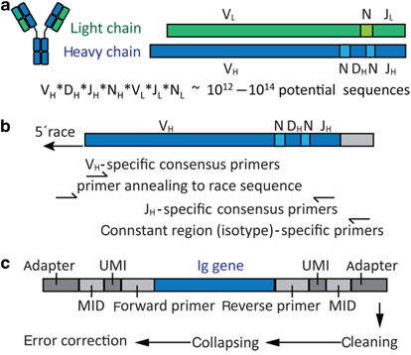
5’ SMART RACE PCR: applied using immune receptor-specific primers
For immune receptors (B and T cells), forward primers may be placed within the variable region or anneal to upstream sequences that were added by race PCR to the 5′-end.
Reverse primers can be placed in the constant regions.
Additionally, using B-cells as an example, beside Immunoglobulin gene-specific regions, forward and reverse primers comprise additional sequences allowing for next-generation sequencing (NGS) and data analysis.
PMID: 25389035

Slide 18
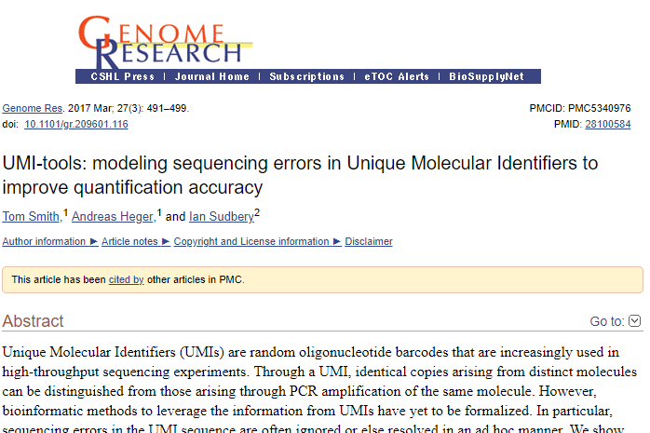
UMI and MID sample tracking systems
Unique molecular identifier (UMI) can be used to quantify NGS repertoire information and determine clonal sizes.
Molecular identification tags (MID) identify samples and allow combining multiple samples in one sequence run.
PMID: 25389035
PMCID: PMC5340976
; PMID: 28993443

Slide 19
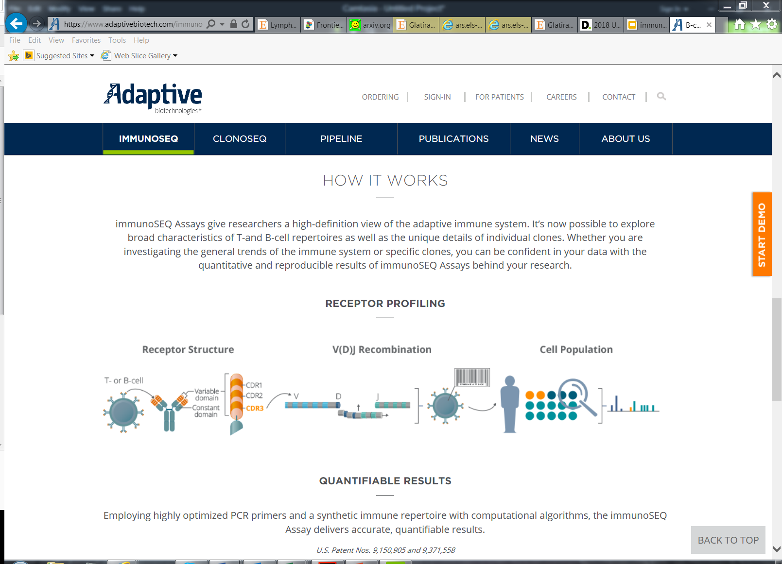
Multiplex PCR: bias-controlled approach from Adaptive Biotechnologies)

Slide 20
Video #2
https://vimeo.com/269299313
Enter password

Slide 21
Summary: Approaches for immune sequencing
Immunoglobulin and T cell receptor genes are technically challenging sequencing targets.
Various methods can be used for antigen receptor repertoire sequencing.
High throughput repertoire sequencing has applications in basic and clinical immunology.

Slide 22
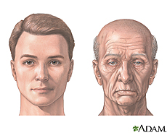
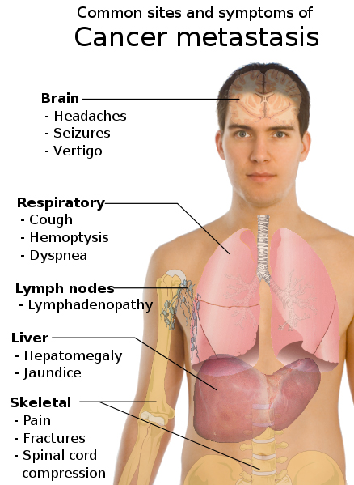
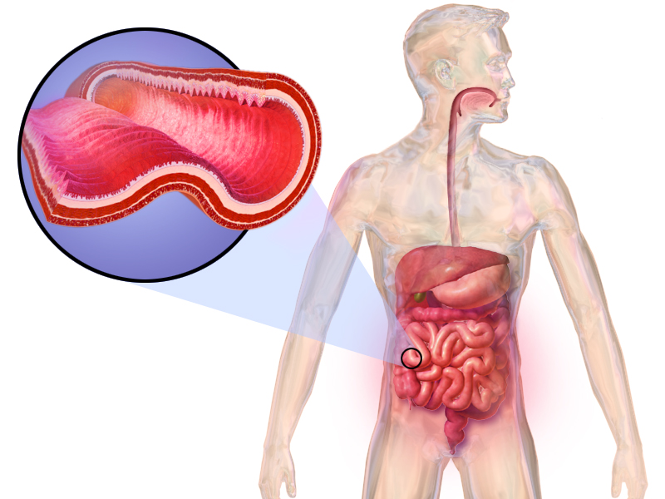
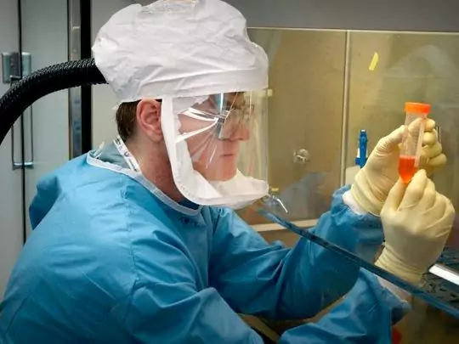

Applications of immune (repertoire) sequencing
Aging
DOI: 10.1126/sciimmunol.aah6506
PMID: 21248263
Cancer
Autoimmunity
PMID: 29602780
PMCID: PMC5702608
PMID: 29602773
PMID: 28864286
Infection
PMID: 29385144
PMID: 28860025

Slide 23
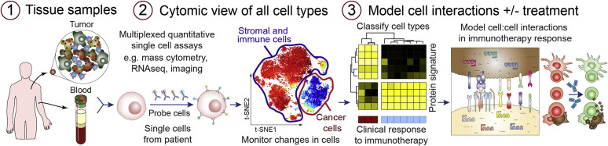
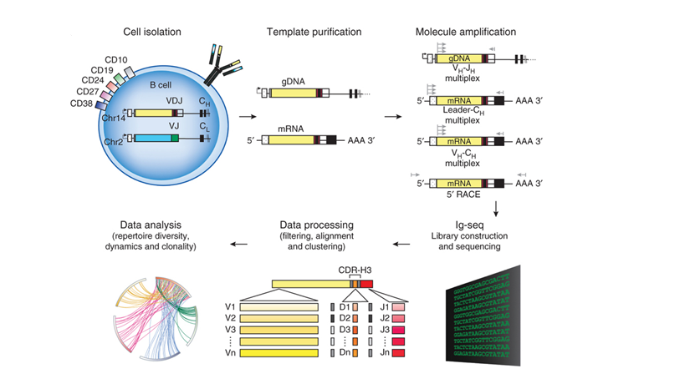
Sample Collection for immune sequencing studies (example approach)
or
Sample source
Template isolation
Immune sequencing
Read level data processing
Data analysis output
PMID: 24441474
https://search.creativecommons.org/
https://vdjserver.org

Slide 24
Summary: Applications and sample processing of immune sequencing
Immune Repertoire sequencing can be applied to a variety of diseases including cancer, infectious diseases, autoimmunity, and aging.
Samples can be collected from various experimental sources including PBMCs, whole cell lysate and cerebrospinal fluid (csf).
VDJServer provides a complete analysis ecosystem to support analysis of datasets derived from any of the immune sequencing approaches and platforms.

Slide 25
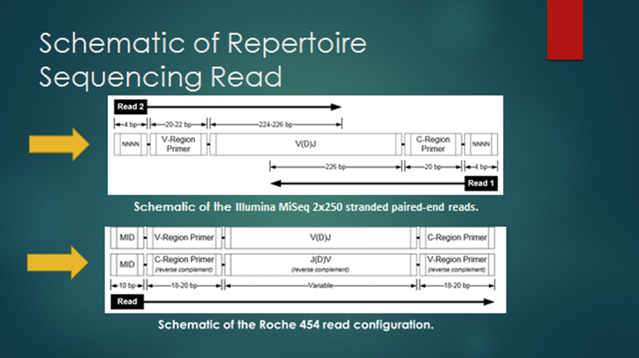
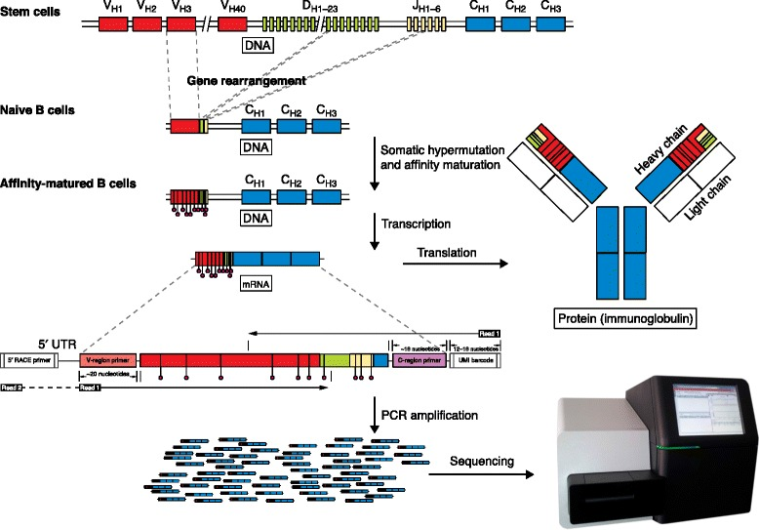
We will be looking at how immune sequencing output data files are analyzed using the VDJServer web portal
Immune sequencing process
Read level (Output) data files generated
Immune repertoire analysis
PMID: 26589402
https://presto.readthedocs.io/en/version-0.5.7---maskprimers-extract/
https://vdjserver.org

Slide 26


Slide 28
A brief introduction to the Workflow and key steps in data analysis for immune sequencing using VDJServer

Slide 29


Slide 30

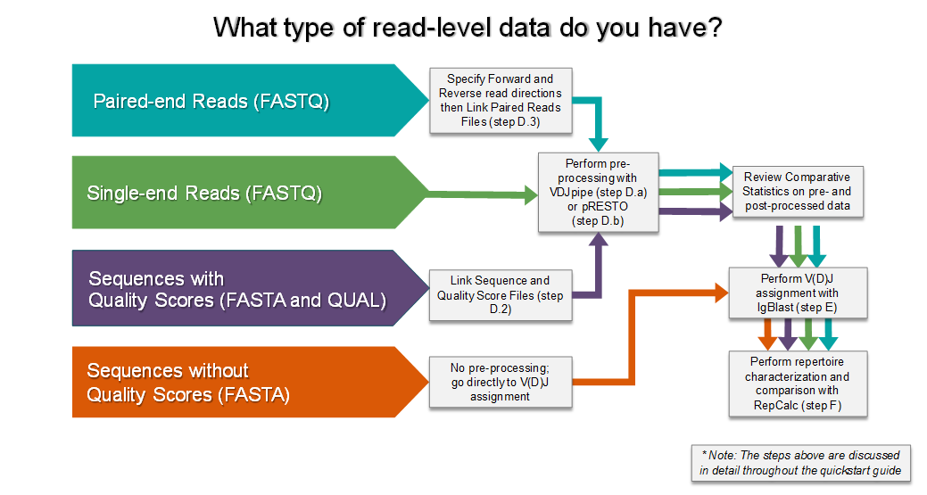
Workflow overview (at a glance) for analysis of immune sequencing data
Immune sequencing process
Read level (Output) data files generated
Immune repertoire analysis
using VDJServer
https://vdjserver.org

Slide 31
Using the VDJServer web portal you can obtain repertoire analysis results in an easy as 5 steps
Step 1: Identify you read level data file type
1
Step 2: pre-processing (if required based upon read level data file); otherwise skip to step 3
2
Step 3: VDJ assignment (using the IgBlast application)
3
Step 4: Reperotire calculations
4
Step 5: obtain visualizations and additional output
5

Slide 32
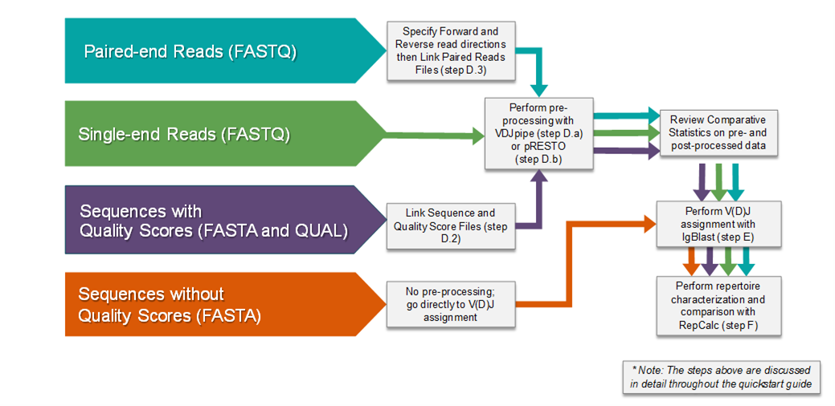
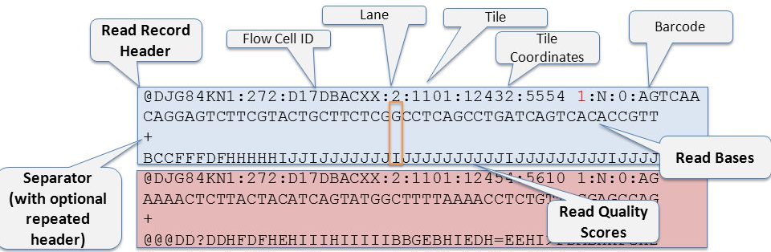
Read level data (type): Step 1 What type of read level data file do you have?
FASTQ Format (Illumina example)
FASTA Format (Adaptive Biot. example)
>1_103
TCTGAACTAAACCTGAGCTCTCTGGAGCTGGGGGACTCAGCTTTGTATTTCTGTGCCAGCAGCGGAAACACCATATATTT
TGGAGAG
>2_39
CTGATCCTGGAGTCGCCCAGCCCCAACCAGACCTCTCTGTACTTCTGTGCCAGCAGTTTTTCCAATCAGCCCCAGCATTT
TGGTGAT
>3_139
TCCCTGATTCTGGAGTCCGCCAGCACCAACCAGACATCTATGTACCTCTGTGCCATCAGATCTGGAAACACCATATATTT
TGGAGAG
PMC4654805
https://vdjserver.org
https://www.illumina.com/content/dam/illumina-marketing/documents/products/datasheets/datasheet_miseq.pdf

Slide 33

Pre-processing: Step 2
https://vdjserver.org

Slide 34
VDJ assignment: Step 3
https://vdjserver.org

Slide 35

Repertoire calculations: Step 4
https://vdjserver.org

Slide 36
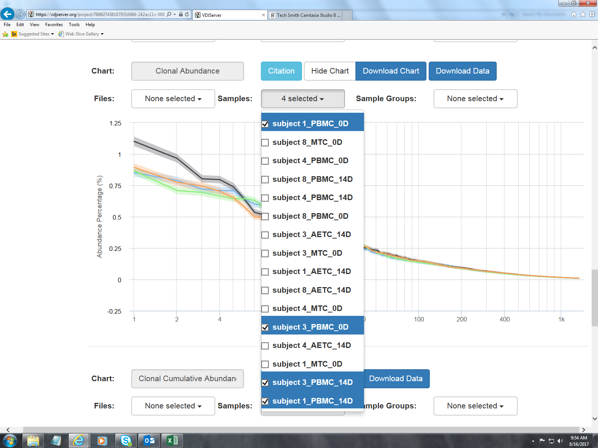
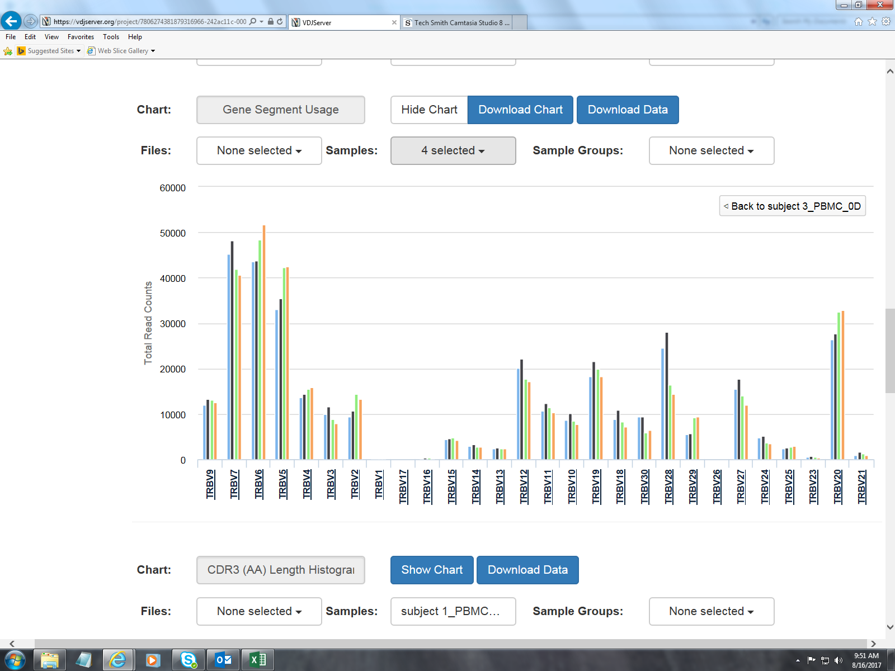
Visualizations and output (step 5) A few example visuals
https://vdjserver.org

Slide 37
Summary: Workflow for analysis of immune sequencing data
VDJServer provides a complete workflow to support analysis of multiple read level data files from immune sequencing studies
VDJServer offers users seamless and reproducible pipelines
VDJServer provides various output files and visualizations to support data interpretation and publications

Slide 38
Adaptive Immune Receptor Repertoire (AIRR) community and data standards

Slide 39
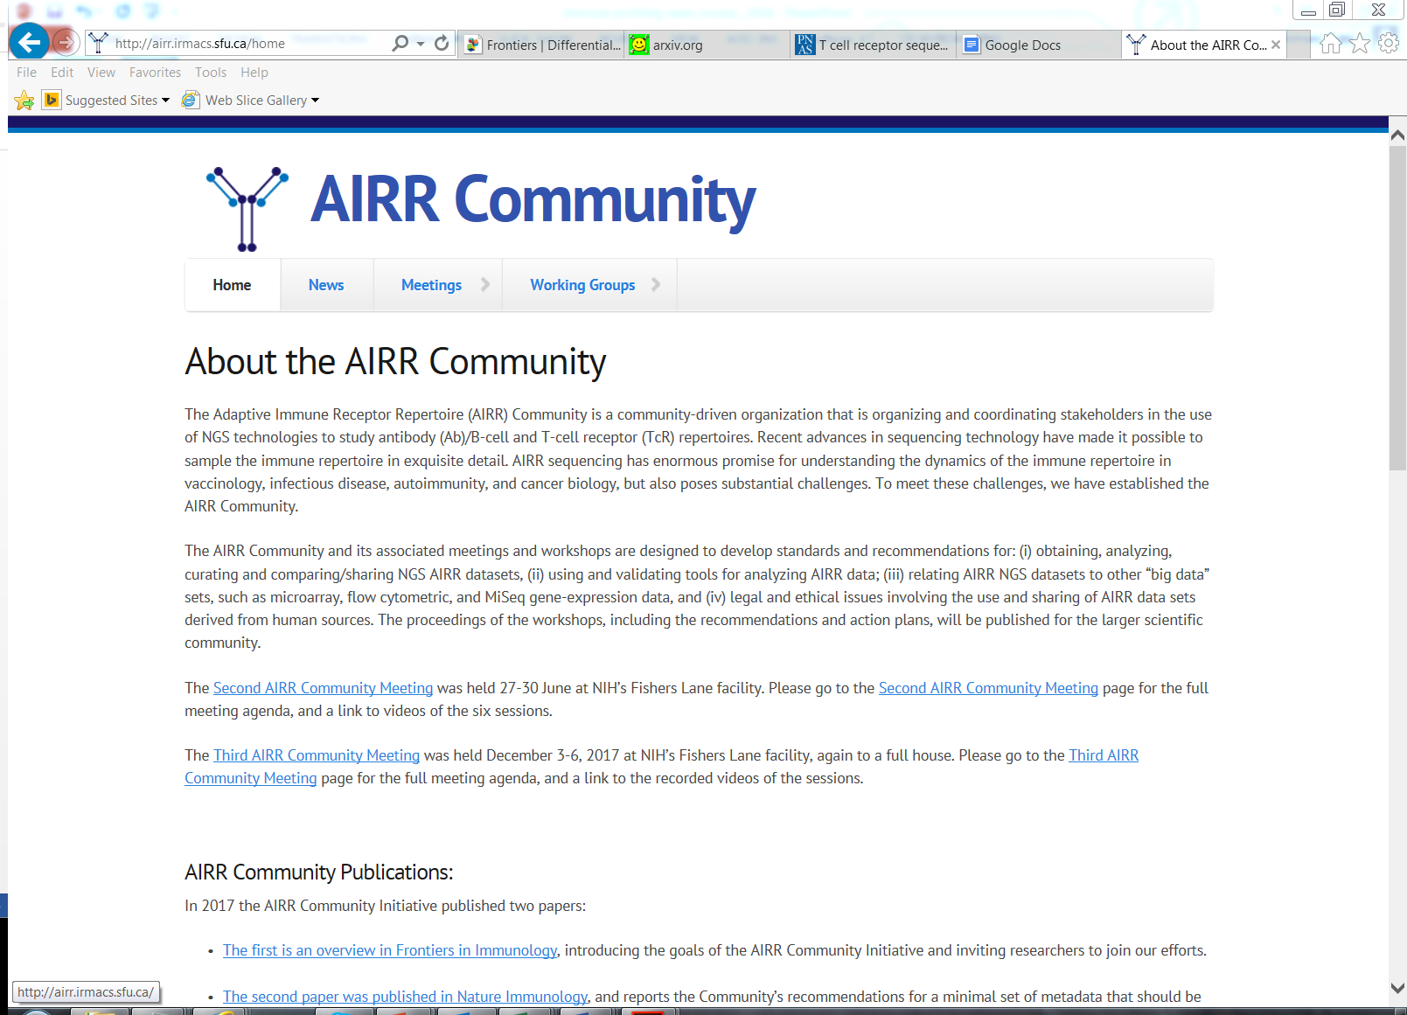
AIRR Community
Airr-community.org

Slide 40
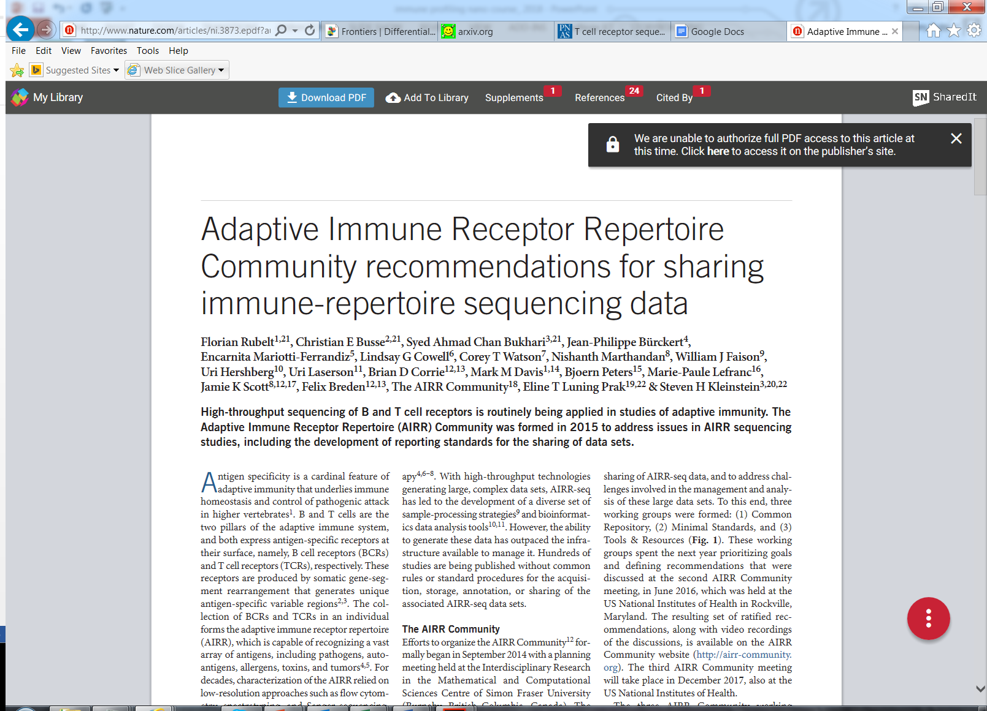
AIRR Community Data Standards
PMCID: PMC5790180

Slide 41
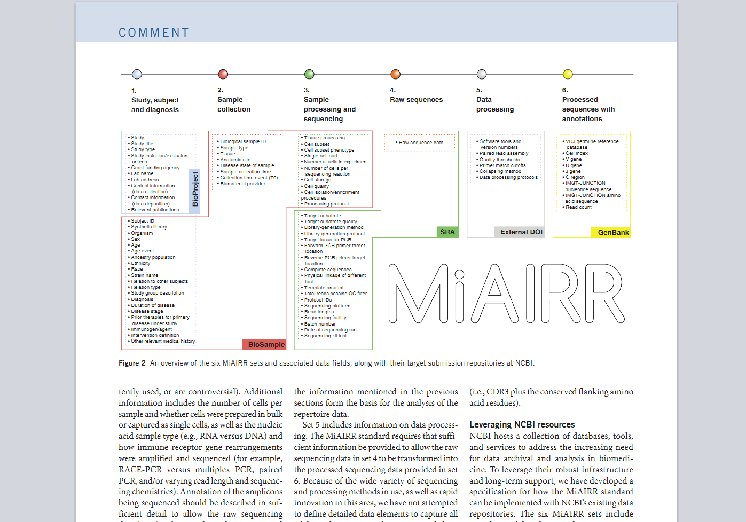
MiAIRR Community Data Standards
PMCID: PMC5790180

Slide 42
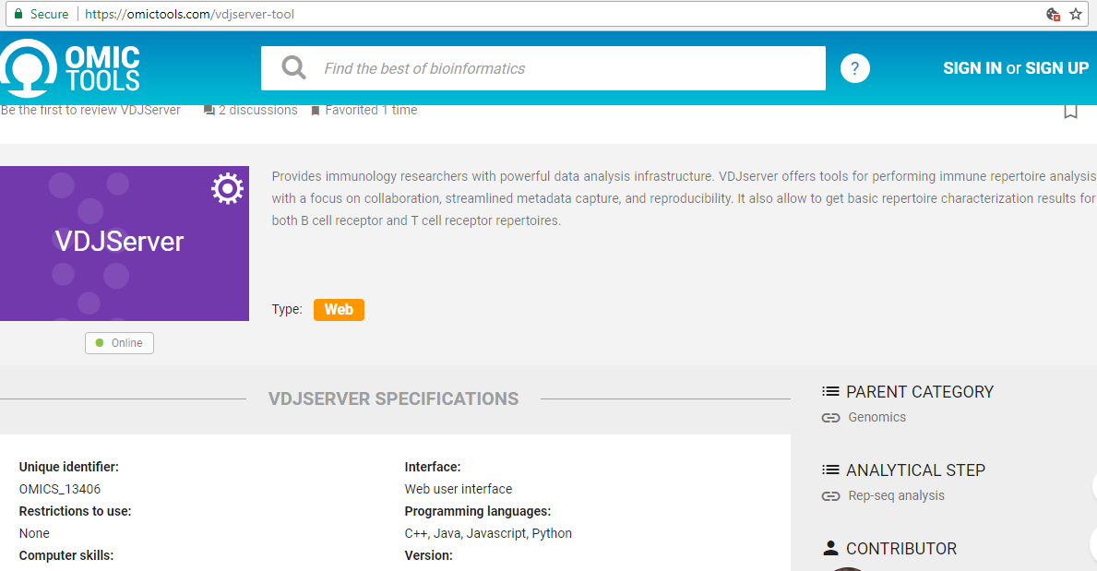
An essential and important community resource
https://vdjserver.org

Slide 43
Summary: AIRR community and data standards
AIRR and emergence of immune sequencing technology provides a mirror into the study of B and T-cells.
Multiple Platforms and underlying methods exist for studying B- and T-cell immune receptors
The AIRR community provides a set of guidelines on how to analyze, interpret and disseminate these types of datasets.

Slide 44
Points for the next session (after the break)
Focus on
Focus on multiplex bias-controlled PCR protocol used by Adaptive Biotechnology
Use
Use dataset from T-Cell immune receptor breast cancer study
Perform
Perform hands-on demonstrations of the workflow steps mentioned and work through each of the steps introduced in greater detail
Explore
Explore VDJServer web portal and discuss related resources for analysis

